Slide 1
Write a program to demonstrate the working of the decision tree based ID3 algorithm. Use an appropriate dataset for building the decision tree and apply this knowledge to classify a new sample.
ML – Practical 5A

Slide 2
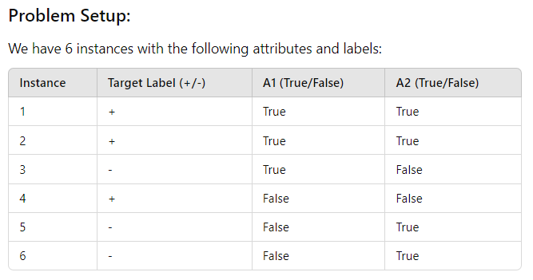
What is ID3 algorithm?

Slide 3
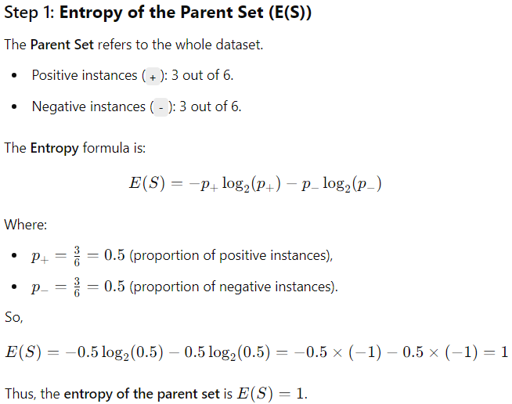


Slide 4
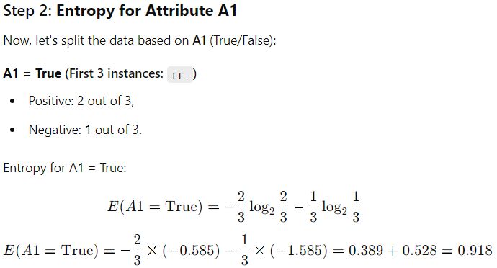

Slide 5
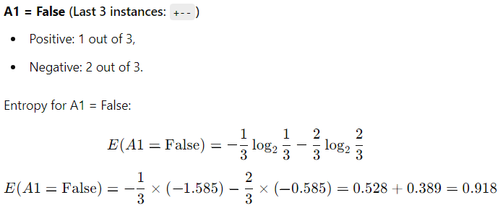

Slide 6
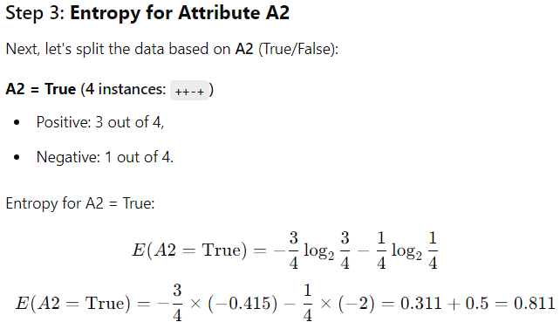

Slide 7
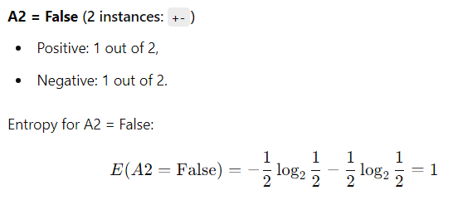

Slide 8
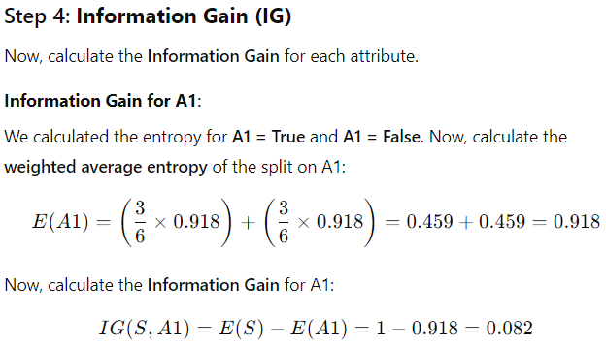

Slide 9
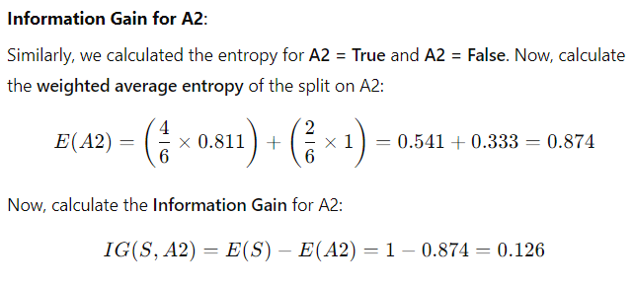
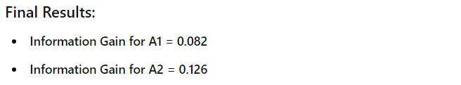


Slide 10
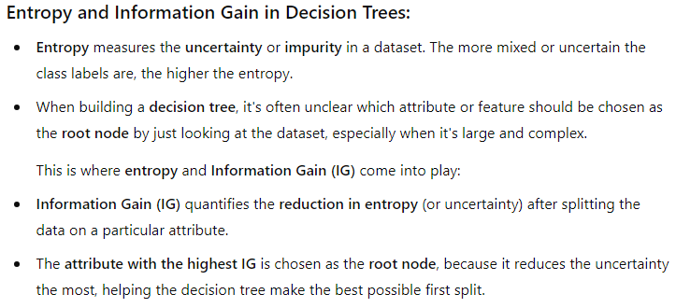

Slide 11





Now, coming to practical:-

Slide 12






Slide 13





Slide 14



Slide 15
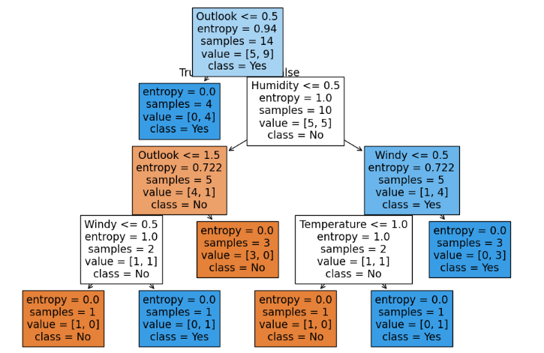

Slide 16
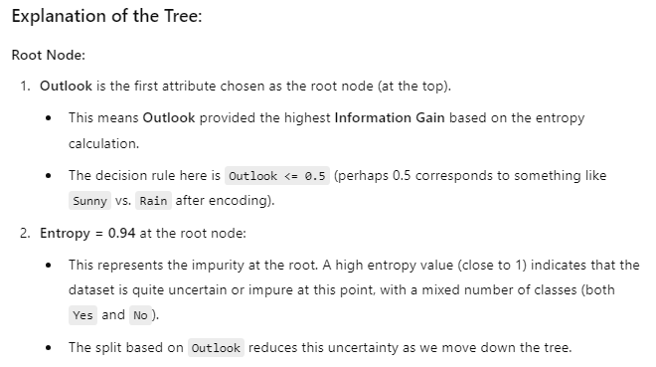

Slide 17
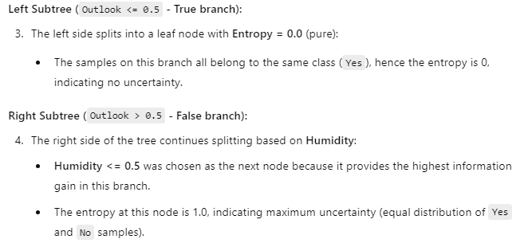

Slide 18



Slide 19
Write a program to implement k-nearest algorithm to classify the iris dataset.
ML – Practical 5 B

Slide 20




Slide 21

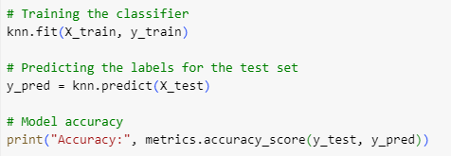

Slide 22




